Slide 1

Culture of biosafety, biosecurity, and responsible conduct in the life sciences
- Quiz -

Slide 2

The World Health Organization (WHO) promotes “a culture of scientific integrity and excellence, distinguished by openness, honesty, accountability and responsibility. Such a culture is the best protection against the possibility of accidents and deliberate misuse, and the best guarantee of scientific progress and development”.
____________________
True
False
Press the space bar to see the correct answer.

Slide 3
Culture is…
____________________
An assembly of organizational policies
The way we really get things done
The way we say we get things done
An assembly of attitudes, beliefs, and patterns of behavior
Press the space bar to see the correct answer.

Slide 4
Within the life sciences, the culture of biosafety, biosecurity, and responsible conduct...
(A) aims to prevent the loss, theft, misuse, and diversion of biological agents, related materials, technology or equipment, and the unintentional or intentional exposure to (or release of) biological agents;
(B) supports, complements or enhances operating procedures, rules, and practices as well as professional standards and ethics.
____________________
A only
B only
Both A & B
Neither A or B
Press the space bar to see the correct answer.

Slide 5
In order to strengthen the culture of biosafety, biosecurity, and responsible conduct in my laboratory, I need to look at:
(A) Management systems;
(B) Behavior of leadership and staff;
(C) Biosafety- and biosecurity-related norms, beliefs, attitudes, and values;
(D) Principles for guiding decisions and behaviors.
____________________
Only A
B & C
None of these
All of these
Press the space bar to see the correct answer.

Slide 6
In the context of organizational culture, laboratory management systems are the processes, procedures, and programs in the organization which make biosafety and biosecurity top priorities and have an important impact on the safety and security functions.
____________________
True
False
Press the space bar to see the correct answer.

Slide 7
Laboratory management systems include, among other features:
(A) Visible biosafety and biosecurity policies;
(B) Clear roles and responsibilities;
(C ) Performance measurements;
(D) Work environment;
(E ) Training and qualifications.
____________________
Only A
Only E
All of these
None of these
Press the space bar to see the correct answer.

Slide 8
Which aspects of leadership behavior contribute to a strong culture of biosafety, biosecurity, and responsible conduct?
(A) Establishing performance expectations for biosafety, biosecurity, and responsible conduct to guide staff in carrying out their responsibilities;
(B) Establishing clear and documented responsibility and authority of each biosafety/biosecurity position within the organization.
(C) Involving staff members in the risk assessment and decision making processes and other activities that affect them
(D) Establishing processes and showing (by example and direction) that workers are expected to look for ways to learn and improve
____________________
All of these
None of these
Only A & B
Only A, B, & C
Press the space bar to see the correct answer.

Slide 9
Characteristics of personnel behavior one should assess in order to determine the strength of a laboratory culture of biosafety, biosecurity, and responsible conduct, include:
(A) Professional conduct
(B) Personal accountability
(C) Adherence to procedures
(D) Teamwork and cooperation
(E) Vigilance
____________________
None of these
All except A
All of these
All except E
Press the space bar to see the correct answer.

Slide 10
What biosafety- and biosecurity-related norms, beliefs, attitudes, and values should one consider to strengthen the culture of biosafety, biosecurity, and responsible conduct?
(A) Awareness of biological risks and threats and management/mitigation strategies;
(B) Awareness of dual use information of concern, its potential for harm and ensuring that it is responsibly used;
(C ) Acknowledgment that scientists have a social responsibility to ensure that advances in the life sciences positively affect people of all nations while reducing the risks posed by their misuse.
____________________
Only A
Only B
A, B, and C
Only C
Press the space bar to see the correct answer.

Slide 11
An effective culture of biosafety, biosecurity, and responsible conduct requires a set of principles that leaders should promote and apply consistently to guide policies, decision-making, management systems, and the behavior of researchers, technicians, and all other staff in a laboratory. Such principles include: motivation; leadership; commitment and responsibility; professionalism and competence; and learning and improvement through applying lessons learned.
___________________
True
False
Press the space bar to see the correct answer.

Slide 12
The principles for guiding decisions and behaviors on biosafety and biosecurity include norms, values, and beliefs that apply to all life sciences professions worldwide.
__________________
False
True
Press the space bar to see the correct answer.

Slide 13
The State Parties to the Biological Weapons Convention encouraged the promotion of a culture of responsibility amongst relevant national professionals and the voluntary development, adoption, and promulgation of codes of conduct.
____________________
True
False
Press the space bar to see the correct answer.

Slide 14
Codes of conduct include norms, values, and beliefs that apply to all life sciences professions worldwide.
____________________
True
False
Press the space bar to see the correct answer.

Slide 15

In general, codes of conduct are:
Developed for most professions;
Increasing in number;
Promulgated as guidelines;
Used to train the current and future scientific community in best practices;
Living documents and subject to change.
__________________
True
False
Press the space bar to see the correct answer.

Slide 16

Examples of codes of conduct include:
(A) DIY Bio Code of Ethics
(B) The International Association of Synthetic Biology (IASB) Code of Conduct for Best Practices in Gene Synthesis
(C ) International Union of Microbiological Societies (IUMS) Code of Ethics against Misuse of Scientific Knowledge, Research and Resources
____________________
Only A
Only B
All of these
Only C
Press the space bar to see the correct answer.

Slide 17
Complacency is the worst enemy of biosafety and biosecurity and is nurtured by a lax organizational culture
____________________
False
True
Press the space bar to see the correct answer.

Slide 18

“Leadership does not provide resources for optimizing biosafety and biosecurity in my laboratory. These are low priority because we have not had an incident in a long time. We have a strong culture of biosafety and biosecurity!”
What is your response?
_______________________________
C. We are safe and secure, no need to spend more money!
A. Way to go!
B. That’s right!
D. This is complacency
Complacency should be brought to the attention of lab management/leadership
Press the space bar to see the correct answer.

Slide 19
An insider threat occurs only when an individual commits a dangerous act with malicious intent
____________________
True
False
False. Poor judgment, in the name of a private interest or even in pursuit of a distorted vision of the public good, also leads to insider threats
Press the space bar to see the correct answer.

Slide 20
Insider threats can be mitigated by:
- building a strong biosecurity culture,
- fighting complacency in reporting incidents and concerns, and by
- holding periodic meetings with laboratory personnel to reinforce values and moral obligations, and to emphasize observations that should be reported.
____________________
True
False
Press the space bar to see the correct answer.

Slide 21
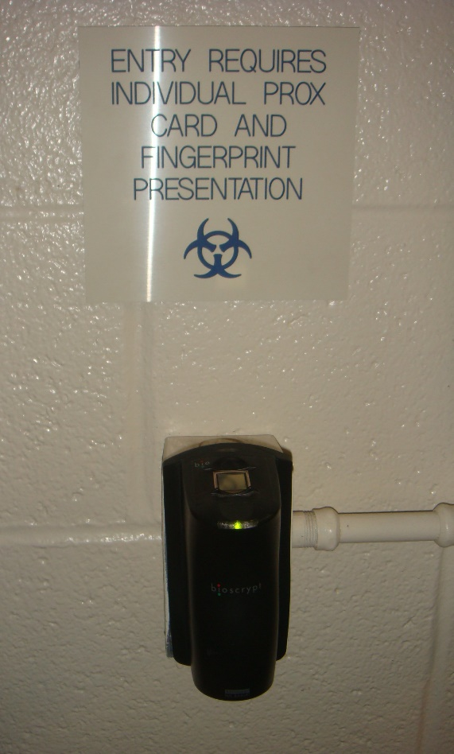
“My lab has state-of-the-art access security. Sometimes my colleagues and I piggyback into the lab”.
____________________
A. This shows a lax culture of biosafety and biosecurity.
B. There is nothing wrong with that.
Press the space bar to see the correct answer.

Slide 22
Any system in which humans are involved will, at some point, be disrupted by human error.
____________________
True
False
Press the space bar to see the correct answer.

Slide 23
Since the risk is never zero, organizations distinguish themselves not by eliminating the possibility of human error, but by handling the inevitable mistakes well and by developing or sustaining an effective organizational culture.
____________________
True
False
Press the space bar to see the correct answer.

Slide 24
Strengthening an organizational culture of biosafety, biosecurity, and responsible conduct in the life sciences is an intrinsic part of a laboratory quality management system. Such culture includes: management systems (organization and leadership); leadership and personnel behavior; principles for guiding decisions and behavior; and beliefs and attitudes on biosafety, biosecurity and responsible conduct of research.
____________________
True
False
Press the space bar to see the correct answer.

Slide 25
The oversight of dual use research of concern (i.e. policies, practices, and procedures to ensure that the dual use research of concern is identified and risk mitigation measures are implemented, where applicable) is an example of an area where the organizational culture is important.
____________________
True. All scientists must uphold the integrity of science and prevent its misuse.
False. Organizational culture has nothing to do with this.
Press the space bar to see the correct answer.

Slide 26
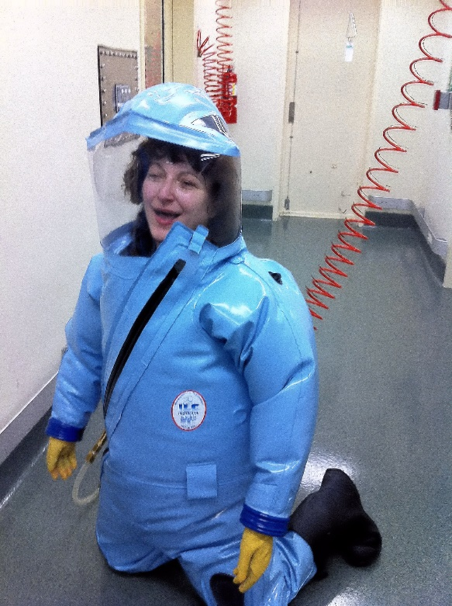
What element(s) of organizational culture are at fault in this situation?
____________________
A. Both B & C
B. Management systems and leadership/personnel behavior
C. Biosafety- and biosecurity-related norms, beliefs, attitudes, and values; as well as principles for guiding decisions and behaviors.
D. None of these
“I’m very tired since I stayed late last night but my supervisor wants me to do my experiments anyway.”
Press the space bar to see the correct answer.

Slide 27
Regulations or guidelines alone cannot ensure safe, secure, and responsible practices in the laboratory. Strengthening the culture of biosafety and biosecurity will help achieve a congruent set of behaviors, attitudes, and policies that enable a person or an organization to work in a safe and secure manner with biological agents and toxins, and have a process by which individuals and organizations respond appropriately and effectively to biological hazards.
____________________
True
False
Press the space bar to see the correct answer.

Slide 28
Bioethics training should promote responsible, safe, and secure research and diagnostic practices. It should provide tools and guidance to laboratory workers and institutions that facilitate open discussion and analysis of potential challenges and dilemmas associated with their work, including weighing potential risks and benefits, dual use concerns, and the possibility of accidents or misuse of life sciences materials, technology, and information.
____________________
True
False
Press the space bar to see the correct answer.

Slide 29
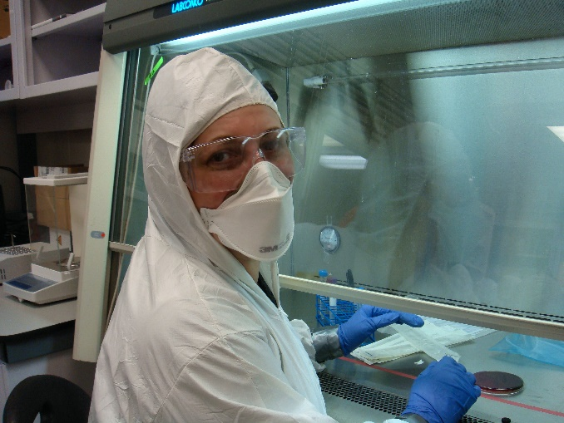
Is there a need for culture change in this laboratory?
_______________
YES
NO
“This biological safety cabinet is defective. My supervisor agreed that as long as I use my PPE I can do the work. We are using the grant money left to go to a conference rather than to fix the equipment”.
Press the space bar to see the correct answer.

Slide 30
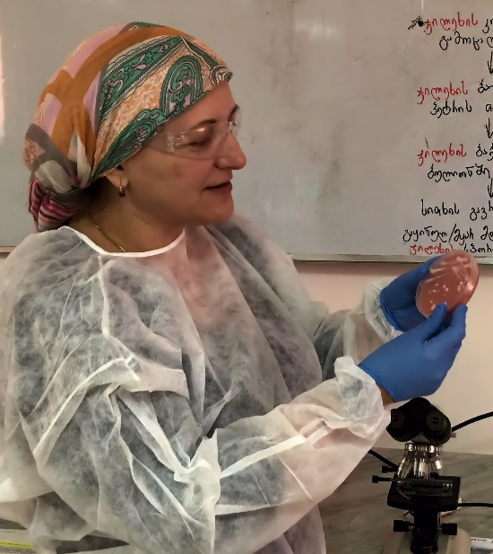
“Sniffing bacterial cultures on agar plates is a useful practice. The SOP says not to do this but everyone in my lab does it anyway. Why shouldn’t I?”
____________________
A. Don’t do it, even when the risk is low. A strong organizational culture will complement and reinforce the knowledge and skills acquired through biosafety and biosecurity training (including compliance with SOPs, rules, and regulations).
B. Go ahead. That’s the way we really get things done around here.
To sniff or not to sniff? That is the question…
Press the space bar to see the correct answer.

Slide 31
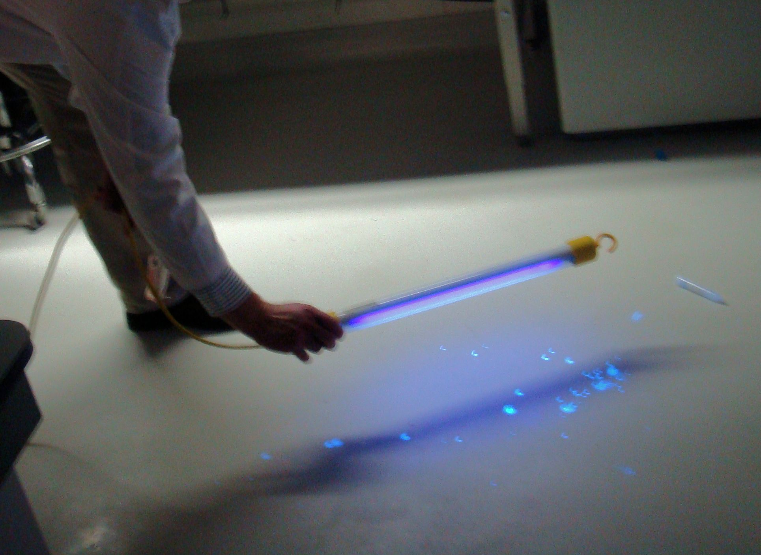
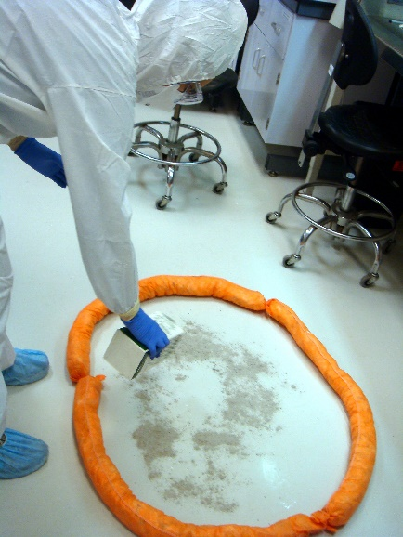
“I spilled my viral stock on the floor but I cleaned it thoroughly. I see no need to report this to my supervisor”.
____________________
A. A culture of biosafety, biosecurity, and responsible conduct includes reporting incidents and near misses. Don’t put your co-workers and yourself at risk of acquiring an infection.
B. This has nothing to do with organizational culture. Nobody saw this and I’m good at cleaning up.
“Not clean enough””
What is the appropriate response ?
Press the space bar to see the correct answer.

Slide 32
This quiz is partly based on IAEA guidance on nuclear safety and security culture. For feedback, email: dana.perkins@hhs.gov
____________________

